Slide 1
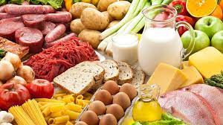
Components of Food
Chapter 2

Slide 2
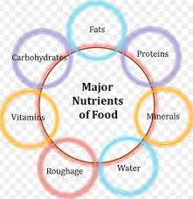
Nutrients
The chemical substances in the food are the nutrients.
Different types
Carbohydrate
Protein
Fats
Vitamin
Minerals
Water
Roughage

Slide 3
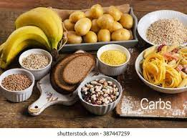
Carbohydrate
Sugar and starch are carbohydrates
They give energy
Sugar give energy immediately but the starch give the energy very slowly
The excess carbohydrates is stored in our body

Slide 4
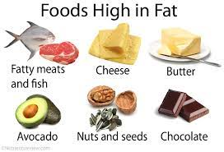
Fats – an adult needs 70 to 80 g per day
They give more energy than carbohydrates
They are normally stored under the skin, around the heart and kidney
They keep our body warm
There are different kinds of fats
Unsaturated and saturated fats

Slide 5
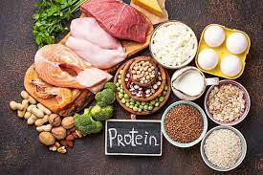
Proteins – 1g per kg of body weight
Our body cells are made of proteins they also need proteins to worn out the old cells
The sick people and the growing children need more proteins

Slide 6
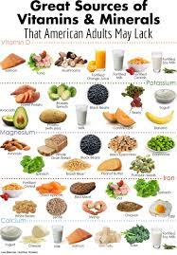
Vitamins and Minerals
Minerals are certain elements
They perform particular function in our body
They are also required in small quantities
Their deficiency leads to diseases
Vitamin are required in small quantities and they are essential for proper functioning of the body
There are 20 types of vitamin
Deficiency of vitamin lead to disease

Slide 7
Water
70% of our body weight
Water is present inside the cells and in the intermediate space of cells.
The liquid part of the blood
Life process cannot occur without water.
Absorbs nutrients from food,
Transport nutrient through out the body
Collects waste and supply food to all parts of the body
Maintains out body temperature by means of sweat from the skin.
Water do not provide any energy but plays a vital part in all the biological and chemical activities inside our body
Normally every one should intake 6 to 8 glasses of water.

Slide 8
Roughage
Fruits and vegetables contain the carbohydrates that need fibre for its complete digestion.
They are called Roughage
They add bulkiness for our diet
The digestive system need the roughage to push the digesting and digested food freely through the system
They prevents the constipation and ensures proper bowel movement of the food
They also reduse the heart disease and bowel cancer

Slide 9
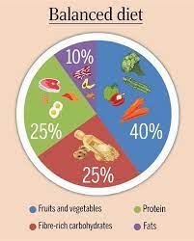
Nutrient and Balanced diet
https://youtu.be/Z51bWG17m-Q

Slide 10
Deficiency diseases
When there is deficient in any nutrient leads to deficiency disease.
The deficiency disease can be cured by supplying the required nutrient to the body
Carbohydrate deficiency
Around 320g of cereals are needed by the 12 years old boy/girl to get enough energy for a day.
Deficiency of it leads to weak and lack of stamina to do any work
Excess of carbohydrates leads to obesity when the unused carbohydrates are stored in the body.

Slide 11
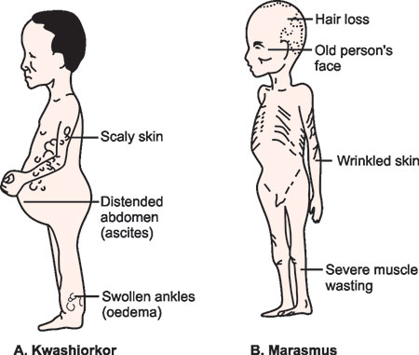
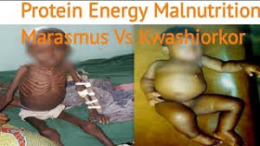
Protein deficiency

Slide 12
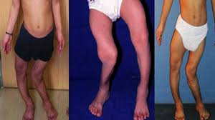
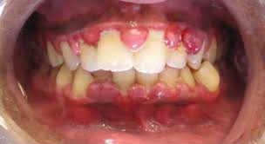
Vitamins deficiency
Vitamin D deficiency leads to Rickets
Bow legs, pigeon chest, bending of spine – symptoms
Pain the bones and loss of tooth enamel
Adult bones become brittle and tends to fracture
Scurvy: Sailor of 16&17 th century suffered
No fresh fruits
1747 doctor James Lind treated the patient with citrus fruits and cured the scurvy

Slide 13
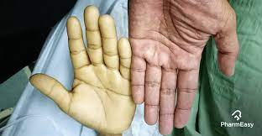
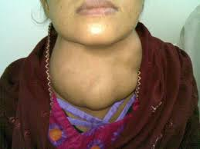
Minerals deficiency
Anaemia – deficiency of Iron
Less in haemoglobin
Thus supply of oxygen to other cells reduce
The person seems to be very tired, loss of appetite
They are caused due to the deficiency of vitamin B12
Thus leads to reduction of red blood cells
Goitre – deficiency of Iodine in diet
Thyroid gland swells and reduce the production of thyroxine which controls the growth
The people in Himalaya region show the deficiency.
Use of iodised salt will reduce the incidence of goitre
https://youtu.be/z0LAOQyk5hU

